Slide 1
Predicting Churn for Bank Customers
Name: Taniya Jain
Enrollment No.: 2018-301-132
Supervisor: Mrs Richa Gupta

Slide 2
OBJECTIVE
I have chosen this project bearing the subsequent objectives in mind:
Visualize which factors contribute to customer churn in the banking sector across the world.
Build a prediction model that will –
Give the details of the customer and analysing to uncover data which is not visible directly.
By doing the location wise split predicting that whether the costumer is going to be churned or not.

Slide 3
INTRODUCTION
Customer churn has become a big issue in many banks because it costs a lot more to acquire a new customer than retaining existing ones. With the use of a customer churn prediction model possible churners in a bank can be identified, and as a result the bank can take some action to prevent them from leaving.
Churn is defined as the movement of customers from one company to another. The reasons can be:-
Availability of latest technology
Costumer – friendly bank staff
Low interest rate
Location
Service offered
Churn rate usually lies in the range from 10% up to 30%

Slide 4
Prediction models are used to identify costumers who are likely to churn.
The model uses historical data on former churners and tries to find some similarity with existing customers.
If some similarity is found, those customers are classified as potential churners.
Literature Survey
HBR Post Link: the-value-of-keeping-the-rightcustomers
Kaggle Bank Churn Link: kaggle dataset
Jill Avery is a senior lecturer at Harvard Business School & an author of HBR’s: Go To Market Tools
Customer Churn Prediction – A case Study in retail published by Sas
Harvard Business School case on HubSpot’s Development of a Customer Happiness Index.

Slide 5
Churn prediction variables
There are four types of variables that are mostly used:-
Customer Demographic Variables
These are mostly used variables in churn prediction
- Age
- Job type
- Gender
- Family size
- Geographical data
2. Perception Variables
It tries to measure how the customer appreciates services or products.
Includes dimensions such as:-
- Quality of services
- Satisfaction with the company
- Locational convenience
- Pricing

Slide 6
Behavioral Variables
Behavioral variables look at the previous behavior of the customers.
- How often he uses the services and products
- Which service or product he uses
Most popular behavioral variables are number of purchases and money
spent.
Macro Environment Variables
Macro environment variables focus on identifying changes in the world
that could affect the costumer.

Slide 7
Dataset Information
It consists of 10000 observations and 14 variables. Independent variables contain information about customers. Dependent variable refers to customer abandonment status.
RowNumber — Corresponds to the record (row) number and has no effect on the output. This column will be removed.
CustomerId — Contains random values and has no effect on customer leaving the bank. This column will be removed.
Surname — The surname of a customer has no impact on their decision to leave the bank. This column will be removed.
CreditScore — Can have an effect on customer churn, since a customer with a higher credit score is less likely to leave the bank.
Geography — A customer’s location can affect their decision to leave the bank. We’ll keep this column.

Slide 8
Gender — It’s interesting to explore whether gender plays a role in a customer leaving the bank. We’ll include this column, too.
Age — This is certainly relevant, since older customers are less likely to leave their bank than younger ones.
Tenure — Refers to the number of years that the customer has been a client of the bank. Normally, older clients are more loyal and less likely to leave a bank.
Balance —As people with a higher balance in their accounts are less likely to leave the bank compared to those with lower balances.
NumOfProducts — Refers to the number of products that a customer has purchased through the bank.
HasCrCard — Denotes whether or not a customer has a credit card. This column is also relevant, since people with a credit card are less likely to leave the bank. (0=No,1=Yes)

Slide 9
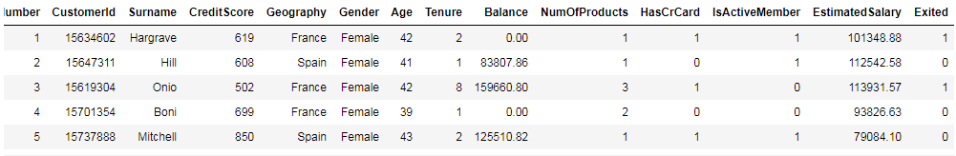
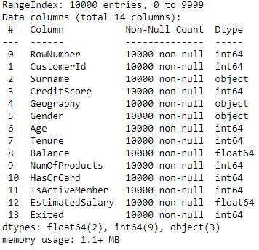
IsActiveMember — Active customers are less likely to leave the bank, so we’ll keep this. (0=No,1=Yes)
EstimatedSalary — As with balance, people with lower salaries are more likely to leave the bank compared to those with higher salaries.
Exited — Whether or not the customer left the bank. This is what we have to predict. (0=No,1=Yes)

Slide 10
TOOLS AND LIBRARIES
Anaconda: is an open source software distribution of R and Python programming languages that are used for scientific computing such as data science, predictive analytics, machine learning, and deep learning applications purposely to simplify package management and deployment.
Jupyter Notebook: is an open free source web application that is used for data cleaning and transformation, numerical, simulation, statistical modeling, data visualization and so on.
Matplotlib: is an amazing visualization library in Python programming language for two-dimensional plots of arrays. One of the greatest benefits of visualization is that it allows high dimensionality data to visualize and easily understandable and it consists of several plots like line, bar, scatter, histogram and so on.
Pandas: is the most popular Python programming language package that offers powerful, expensive and flexible data structures that make data manipulation and analysis easy.

Slide 11
Numpy: is the fundamental package for scientific computing in Python programming language that contains a powerful N-dimensional array object and also useful in linear algebra.
Seaborn: is a Python data visualization library based on matplotlib that provides high-level interface for drawing attractive and informative statistical graphics.
Sci-kit Learn: it is a free machine learning library for Python programming language that designed to interoperate with Python numerical Numpy and scientific libraries SciPy. Also, it can be used for classification, regression and clustering algorithms including support vector machine, linear and logistic regression, random forests, gradient boosting, decision tree, K-means and so on.

Slide 12
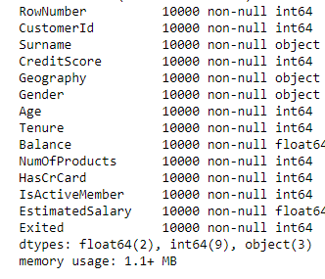
Variable Categorization
Numerical variables - data variable that takes on any value within a finite or infinite interval (e.g. length, test scores, etc.). Numerical variable can also be called a continuous variable because it exhibits the features of continuous data.
Categorical variables – it represents characteristics. Therefore, it can represent labels like gender, language, etc. It can also take on numerical values (ex: 1 for female and 0 for male), these numbers doesn’t have mathematical meaning.
Categorical variables | Numerical variables
Geography | CreditScore
Gender | Age
HasCrCard | Tenure
IsActiveMember | Balance
Exited | NumOfProducts
 | EstimatedSalary

Slide 13
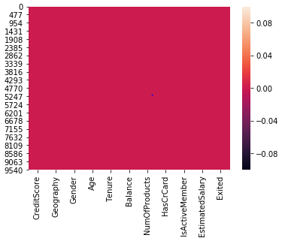
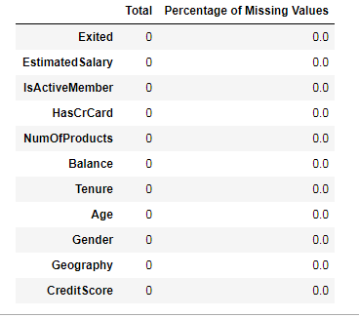
PRE-PROCESSING DATA ANALYSES
The df has 10000 rows with 14 attributes. We review this further to identify what attributes will be necessary and what data manipulation needs to be carried out before Exploratory analysis and prediction modelling.
Missing Data Analysis
There is no missing value in the dataset.

Slide 14
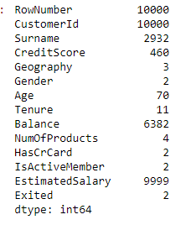

From the above, we will not require the first 2 attributes as they are specific to a customer. It is borderline with the surname as this would result to profiling so we exclude this as well.
Since RowNumber, CustomerId, Surname are redundant in nature so they are of no significance. We are dropping them off.

Slide 15
Project Justification:
As aforementioned, decreasing churn rates is a crucial agenda for all firms mainly because of two reasons
Acquiring new customers is anywhere between 5 to 25 times more expensive. Long term costumers are less costly to serve, they generate higher profits and they may also provide new referrals. Losing a costumer usually leads to loss in profit for the banks.
Increasing retention rates by 5% results in increase in profits anywhere between 25% to 95%.

Slide 16
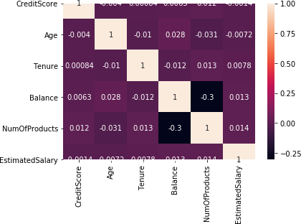
DATA EXPLORATION
Exploratory Data Analysis (EDA) refers to the critical process of performing initial investigation on data so as to discover patterns, spot anomalies, to test hypothesis and to check assumptions with the help of summary statistics and graphical representations.
Check for Multicollinearity
There is no strong correlation
among variables so we can say
that there is no multicollinearity.

Slide 17
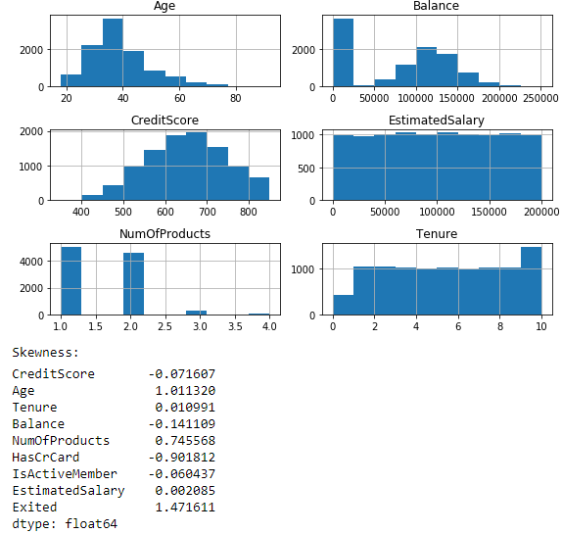
Check of Skewness
In Age we can see that a slight right skewness is there.

Slide 18
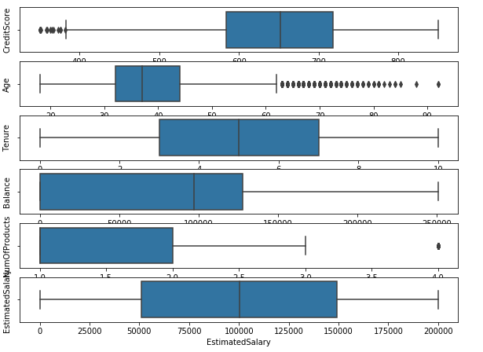
Outliers checking - It is an observation that lies at an abnormal distance from other values in a random space from the population.
We have to treat outliers because it influence accuracy when computed with ML models

Slide 19
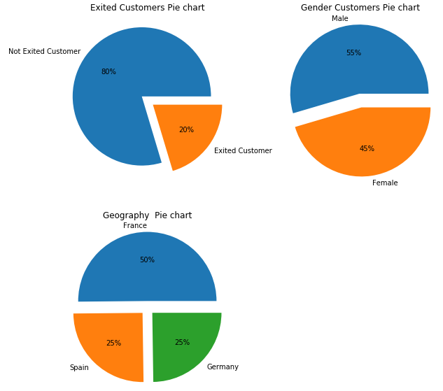
Categorical Column Analysis
20% of customers
are exiting the bank
and 80% are the
retained customers.
Bank has total 55%
male customers and
45% are female
customers.
50% of customers
are from France
Region,25% from
Spain and 25% from
Germany

Slide 20
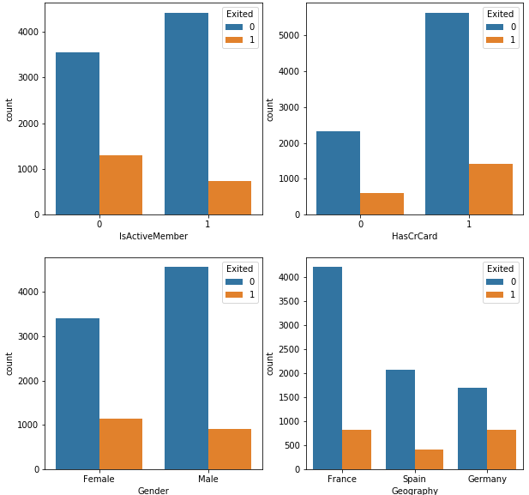
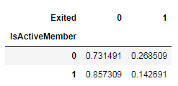
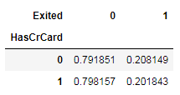
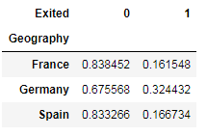
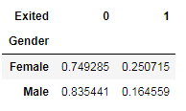
Unsurprisingly the inactive members have a greater churn. Worryingly is that the overall proportion of inactive members is quite high suggesting that the bank may need a program implemented to turn this group to active customers as this will definitely have a positive impact on the customer churn.
Proportion of customers churned are almost same who have credit card and who don't have.
Majority of customer churned are Females.
Majority of the customers are from France but the people exiting proportion is greater in Germany rather than having small proportion of customers.

Slide 21
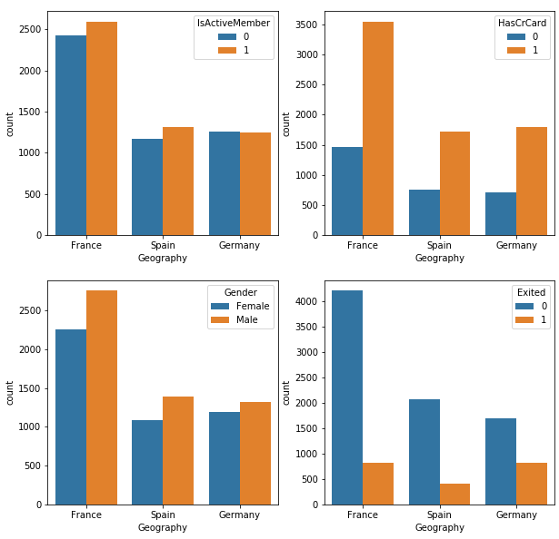
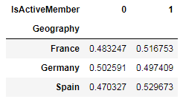
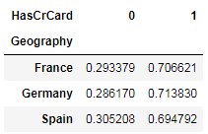
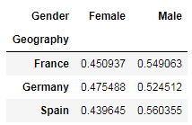
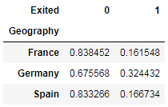
active customers in Germany are even less than half of the total customers.
only 30% of the entire customers in their respective region owns credit card in all three regions
Proportion of females are less in all three regions
customers exiting in Germany is more

Slide 22
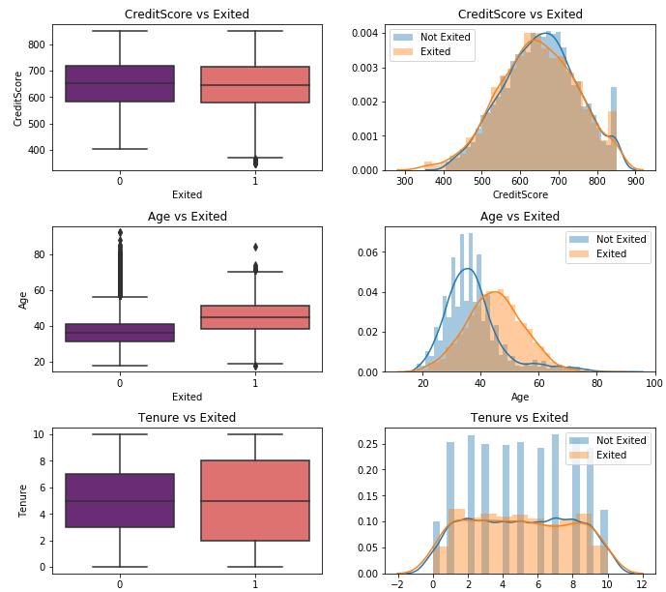
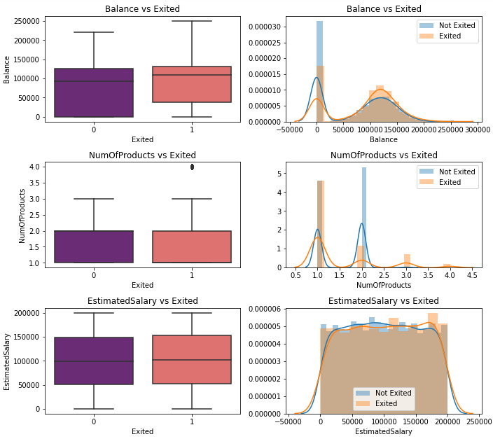
Numerical Column Analysis

Slide 23
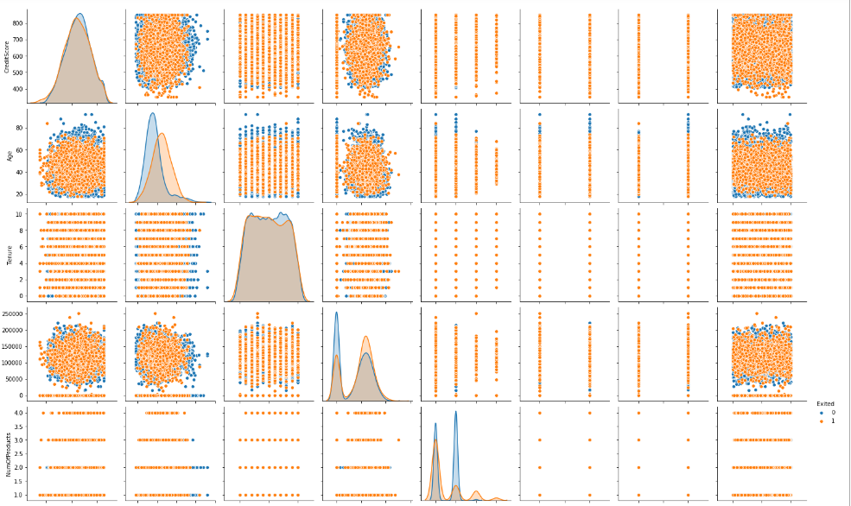
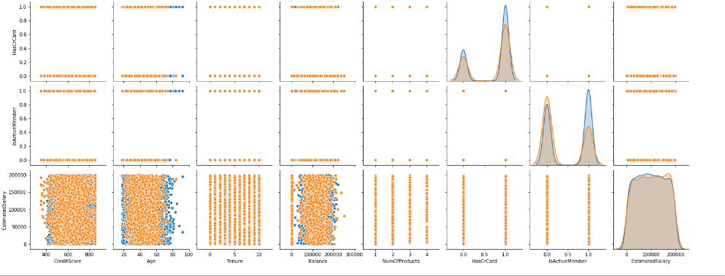

Slide 24
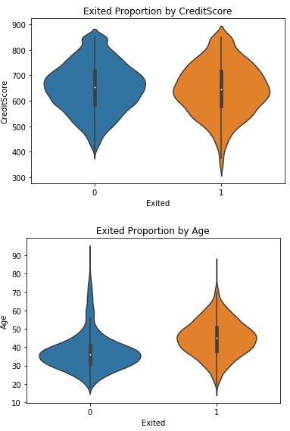
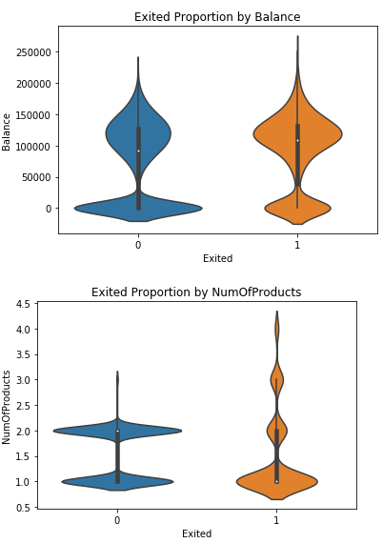
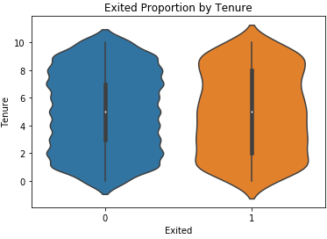
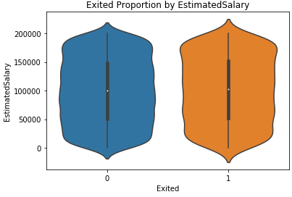

Slide 25
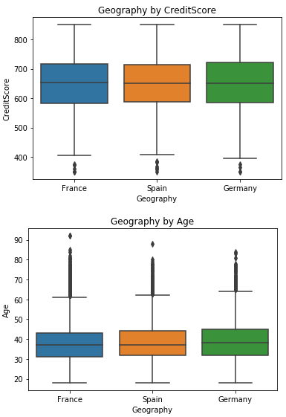
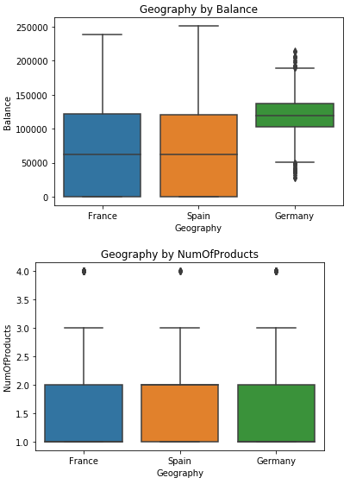
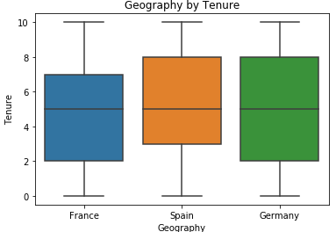
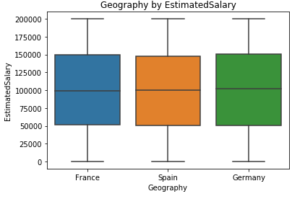
Splitting Region wise for better prediction

Slide 26
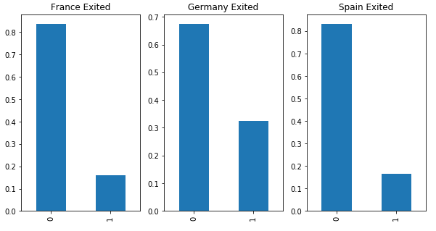
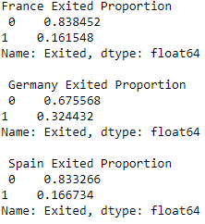
Value Count of France Exited Proportion, Germany Exited Proportion and Spain Exited Proportion
The proportion of people exiting in Germany is comparatively more than Spain and France.

Slide 27
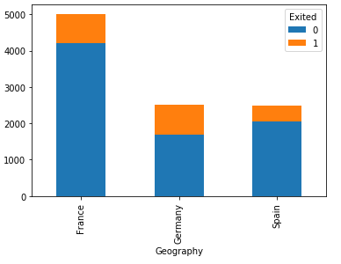

Cross tabulation between Geography and Exited rate
Although the Germany has lesser proportion of customers than France but the exit rate of customers in Germany is largest in comparison to Spain and France.

Slide 28
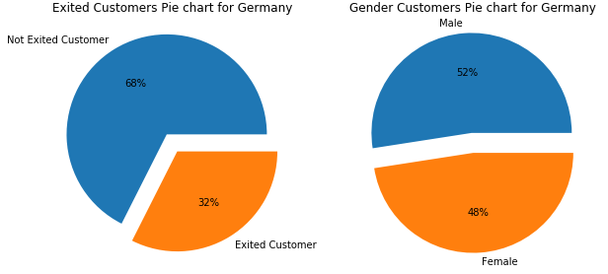
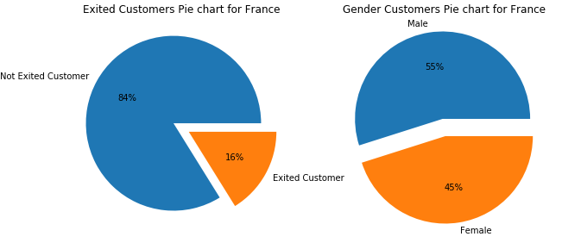
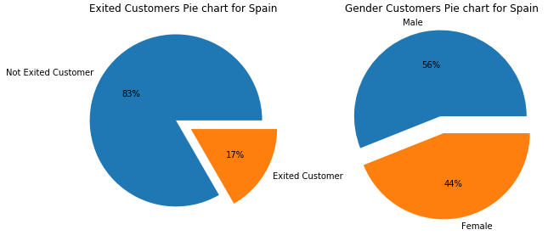
Comparing male and Female Proportions in 3 regions
Germany France
Spain

Slide 29
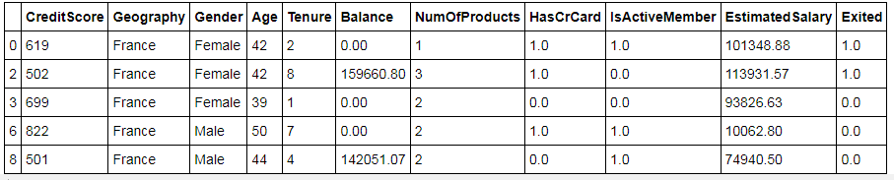
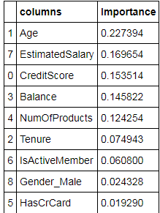
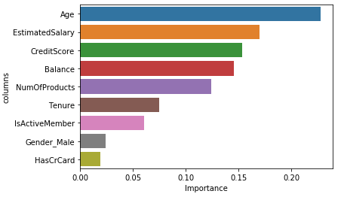
FRANCE REGION
Checking variable importance using Machine Learning

Slide 30
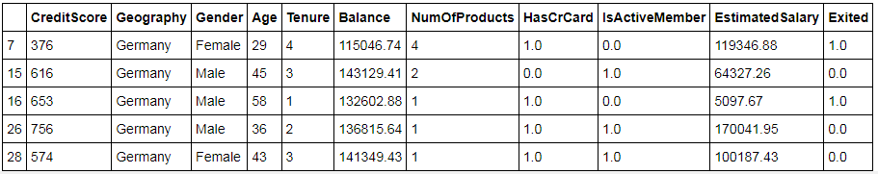
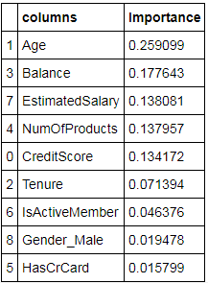
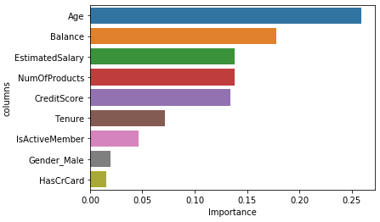
GERMANY REGION
Checking variable importance using Machine Learning

Slide 31
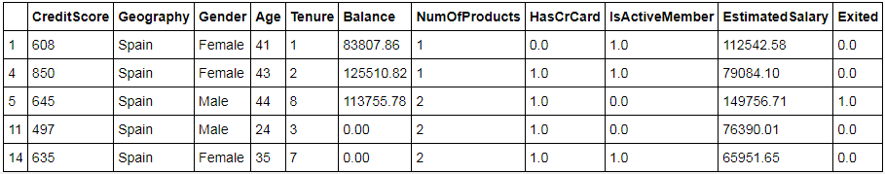
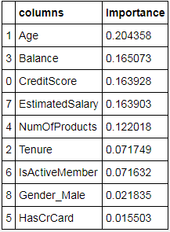
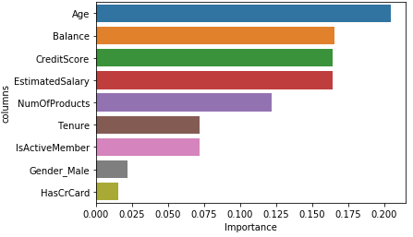
SPAIN REGION
Checking variable importance using Machine Learning

Slide 32
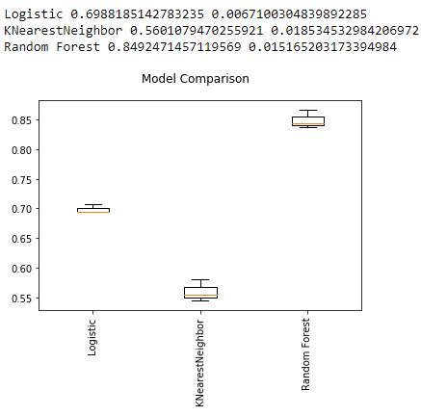
MODEL BUILDING
. For all the countries, we found Random Forest to be working the best. The following are snapshots of the model performance :
GERMANY

Slide 33
As Logistic Regression is a basic model, and has no hyperparameters to tune so it’s the static score which once got can’t be improved further that is why we are getting (roc_auc score =0.69) from this model which is not best.
The KNN algorithm uses 'feature similarity' to predict the class of any new data points. This means that the new point is assigned the class based on how closely it resembles the points that falls inside the no of neighbors we fixed as ‘k’ through hyperparameter tuning. We got the (roc_auc score =0.56) which is lowest in comparison to all other models.
Random forest like its name implies, consists of a large number of individual decision trees that operate as an ensemble. Each individual tree in the random forest predict the class label and the class with the most votes becomes our model's prediction. In this we got (roc_auc score =0.84) which is best in comparison to all above models.

Slide 34
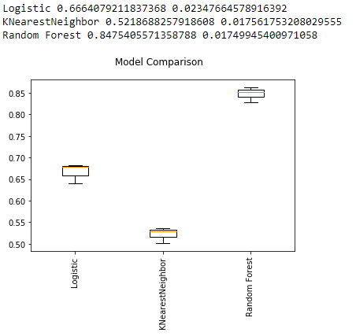
FRANCE
As Logistic Regression is a basic model, and has no hyperparameters to tune so it’s the static score which once got can’t be improved further that is why we are getting (roc_auc score =0.66) from this model which is not best.

Slide 35
The KNN algorithm uses 'feature similarity' to predict the class of any new data points. This means that the new point is assigned the class based on how closely it resembles the points that falls inside the no of neighbors we fixed as ‘k’ through hyperparameter tuning. We got the (roc_auc score =0.52) which is lowest in comparison to all other models.
Random forest like its name implies, consists of a large number of individual decision trees that operate as an ensemble. Each individual tree in the random forest predict the class label and the class with the most votes becomes our model's prediction. In this we got (roc_auc score =0.84) which is best in comparison to all above models.

Slide 36
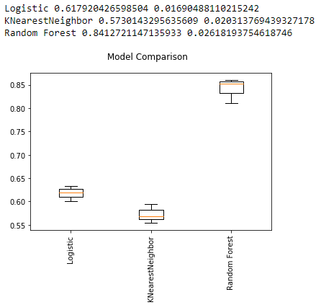
SPAIN
As Logistic Regression is a basic model, and has no hyperparameters to tune so it’s the static score which once got can’t be improved further that is why we are getting (roc_auc score =0.61) from this model which is not best.

Slide 37
The KNN algorithm uses 'feature similarity' to predict the class of any new data points. This means that the new point is assigned the class based on how closely it resembles the points that falls inside the no of neighbors we fixed as ‘k’ through hyperparameter tuning. We got the (roc_auc score =0.57) which is lowest in comparison to all other models.
Random forest like its name implies, consists of a large number of individual decision trees that operate as an ensemble. Each individual tree in the random forest predict the class label and the class with the most votes becomes our model's prediction. In this we got (roc_auc score =0.84) which is best in comparison to all above models.

Slide 38
OVERVIEW OF FINAL PROJECT
Build 4 models based on country
France
Germany
Spain
Unknown (aggregating
all 3 model result)
Logistic Regression, KNN,
Random forest and more….
DATA PREPROCESSING
MODEL BUILDING AND REFINING
Assigning categorical missing values
Label encoding categorical
Splitting training data into 4 segments based on country = ( France, Germany, Spain, Unknown)

Slide 39
FUTURE SCOPE
Amy Gallo, an executive coach and author of Harvard Business Review, claims in a post1 she wrote on HBR that acquiring a new customer is anywhere between 5 to 25 times more expensive than retaining an existing one! To reinforce her claim, she refers to a research done by Frederick Reichheld of Bain & Company that shows increasing customer retention rates by 5% increases profits by 25% to 95%.
Bearing this in mind, in future we propose a Predictive Model that is reinforced with Probabilistic Model. Targeting those customers that are in the vicinity of the threshold probability (0.5) of churn would help tremendously as they are the easiest to pull back. Customer services can concentrate on the factors that we propose that influence the churn rate the most to organize retention campaigns.
LIMITATIONS
The one problem with our model is that if we had the required domain knowledge, we could have been able to implement the Probabilistic approach for the project but we cannot as it won’t be accurate.

